Slide 1
Exploiting & Defense Day 2 Recap

Slide 2
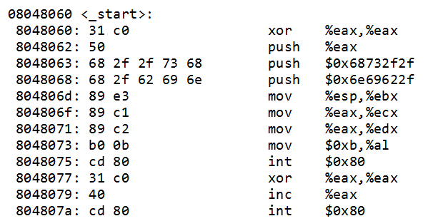
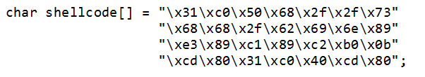
Shellcode! Example in one slide

Slide 3
Syscalls
How to call a syscall:
mov eax <system_call_number>
int 0x80
Arguments in:
EBX
ECX
EDX
…

Slide 4
x32 Call Convention
void main(void) {
int blubb = 0;
foobar(blubb);
return;
}
void foobar (int arg1) {
char compass1[];
char compass2[];
}
Save ptr
&blubb
pointer
SIP
SFP
compass1
compass2
allocate
push
pop

Slide 5
x32 Call Convention Details
add():
push 4
push 3
push EIP
jmp add
push ebp
mov ebp, esp,
sub esp, 0x10
…
…
mov esp, ebp ; leave
pop ebp ; leave
pop eip ; ret

Slide 6
Stack based buffer overflow exploit
0xFF00
char firstname[64]
SIP
0xAA00
CODE CODE CODE CODE CODE
AA00
Jump to buffer with shellcode

Slide 7
So…
Intel Architecture
Buffer Overflow
Memory Layout
C Arrays
BoF Exploit
Assembler
Remote Exploit
Shellcode
Exploit Mitigations
Function Calls
Defeat Exploit Mitigations
Debugging

